Slide 1
Effective Leadership
,

Slide 2
Four Types of Leaders
Autocratic
Democratic
Facilitative
Laissez-Faire

Slide 3
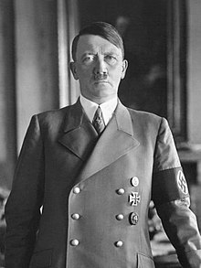
Autocratic Leadership
Autocratic leadership, also known as authoritarian leadership, is a leadership style characterized by individual control over all decisions and little input from group members. Autocratic leaders typically make choices based on their ideas and judgments and rarely accept advice from followers.

Slide 4
Advantages of Autocratic Leadership
Authoritarian leadership can be effective if there is an emergency and a quick decision is needed
There is no one to answer to but yourself
Work can get done quicker
There are fewer opinions and interests that you have to listen to
You have all the power and decision making abilities
Don’t have to worry about groupthink

Slide 5
Disadvantages of Autocratic Leadership
Often results in a dictatorship
Takes away the opinions of others
Eliminates teamwork
There are no checks and balances to ensure good leadership
Examples: Adolf Hitler, Genghis Khan, Napoleon Bonaparte, King Henry VIII
https://`www.youtube.com/watch?v=U6SM057qEy4

Slide 6
Autocratic Leadership Review
Autocratic leadership can be useful in emergency situations were there may not be time to discuss all the options with a group of people
Generally autocratic leadership is not seen as effective and is not the best leadership style

Slide 7
Definition of Democratic Leadership
One of the clearest definitions of democratic leadership comes from John Gastil
“Distributing responsibility among the membership, empowering group members, and aiding the group’s decision-making process”

Slide 8
Democratic Leadership
Democratic leadership, also known as participative leadership.
Subordinates are involved in making decisions.
This headship is focus on subordinates’ contributions.
Everyone is given the opportunity to participate.
The democratic leader holds final responsibility.
Democratic leadership is known to delegate authority to other people, who determine work projects.
Strong democratic leaders inspire trust and respect among followers.

Slide 9
Benefits of Democratic Leadership
Members of the group feel more engaged in the process.
Democratic leadership can lead to better ideas and more creative solutions to problems.
Make the group members to care more about the end results.
Democratic leadership leads to higher productivity among group members.

Slide 10
Democratic Leaders Traits
Honesty
Intelligence
Courage
Creativity
Competence
Fairness

Slide 11
Laissez-Faire Leadership Style
Laissez-faire leadership, also known as delegative leadership, is a type of leadership style in which leaders are hands-off and allow group members to make the decisions. Researchers have found that this is generally the leadership style that leads to the lowest productivity among group members.
It’s important to realize that this leadership style can have both benefits and possible pitfalls. The laissez-faire style of leadership is often dismissed as one that leads to poor group outcomes, but it can be appropriate and effective in a variety of situations

Slide 12

Characteristics of Laissez-Faire Leadership
Very little guidance from leaders
Complete freedom for followers to make decisions
Leaders provide the tools and resources needed
Group members are expected to solve problems on their own
Power is handed over to followers, yet leaders still take responsibility for the groups decisions and actions

Slide 13

Benefits of Laissez-Faire Leadership
When team members have the skills to succeed: Laissez-Faire leadership can be effective in situations where group members are highly skilled, motivated, and capable of working on their own.
When independence is valued: This can be freeing to some group members and help them feel more satisfied with their work. Also, can be used in situations where followers have a high-level of passion and motivation for their work.

Slide 14
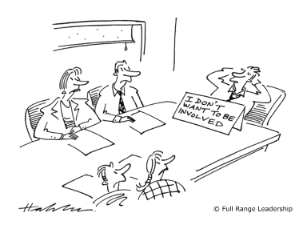
Downsides of Laissez-Faire Leadership
Poor involvement with the group
Lack of role awareness
Low accountability
Passivity and avoidance

Slide 15
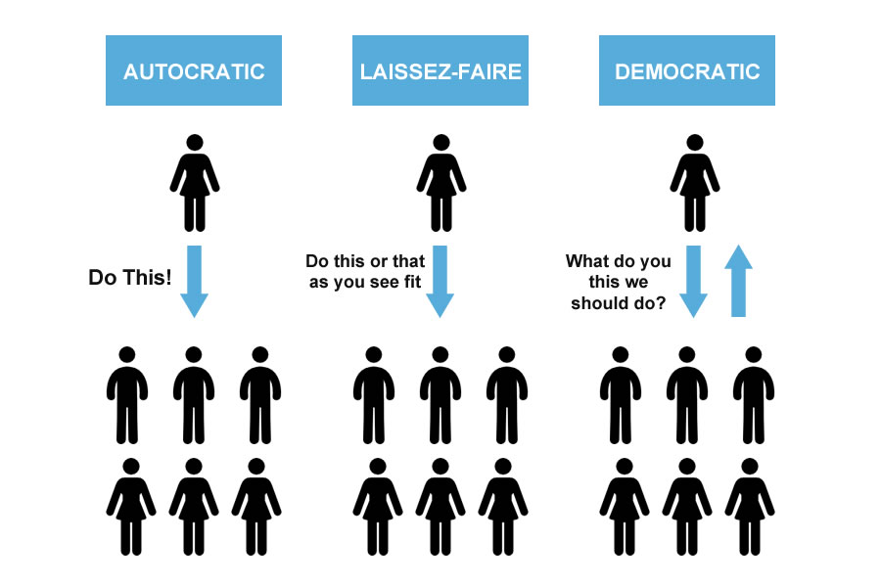
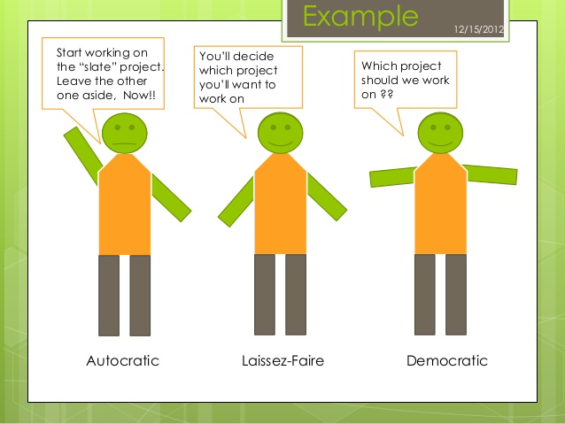

Slide 16
Facilitative Leadership
Facilitative leadership is a people-oriented leadership style. This leadership style is supposed to create interaction between all involved, and make those involved show their strengths, knowledge, and talents to have the greatest outcome. It is a leadership style that takes the best attributes of each person participating and implements those attributes to achieve the goals of the organization.

Slide 17
Advantages of Facilitative Leadership
Makes it easier for people to contribute their ideas and expertise
Makes it easier to speak about problems within the workplace
Everyone works together well because of the team environment
Decisions are agreed upon before being implemented
The morale is high because of positive feedback

Slide 18
Facilitative Leaders:
Encourage participation from everyone in group discussions
Encourage consideration of alternatives from team members
Manage contrasting perspectives and opinions between team members that may result in conflict
They Intervene and provide direction to individuals and groups without completely taking over control
Are supportive of individuals and groups in the workplace

Slide 19
Facilitative Leaders Cont
Reflect with individuals and groups on experiences so that they can learn from the good and bad
Accept the different ways people work, participate, and learn
Make every member of their team become as effective as they can
Create goal achievements for their workers to get them to motivate them and get the best results

Slide 21
Group Activity
The Lifeboat activity
Split up into groups
Elect a leader of the group
Objective: Decide who should stay and who should go on the lifeboat
*Leader should follow instructions on card based on leadership style given

Slide 22
Sources:
Cherry, Kendra, and Steven Gans. “How Does Laissez-Faire Leadership Work?” Verywell Mind, www.verywellmind.com/what-is-laissez-faire-leadership-2795316.
https://www.verywellmind.com/what-is-autocratic-leadership-2795314
https://www.verywellmind.com/what-is-democratic-leadership-2795315
https://online.stu.edu/democratic-participative-leadership/
http://interactioninstitute.org/facilitative-leadership/
http://chfs.ky.gov/NR/rdonlyres/0432D42B-DAF2-43DF-A5E0-7CDEFA86F982/0/FLandInterventionImplementationPracticesMD.pdf
https://www.slideshare.net/BonnerFoundation/facilitative-leadership-2014
https://asae.cms-plus.com/files/FileDownloads/HandOuts/SmallPrograms/Pre-Reading%20December%20Facilitation.pdf

